Slide 1
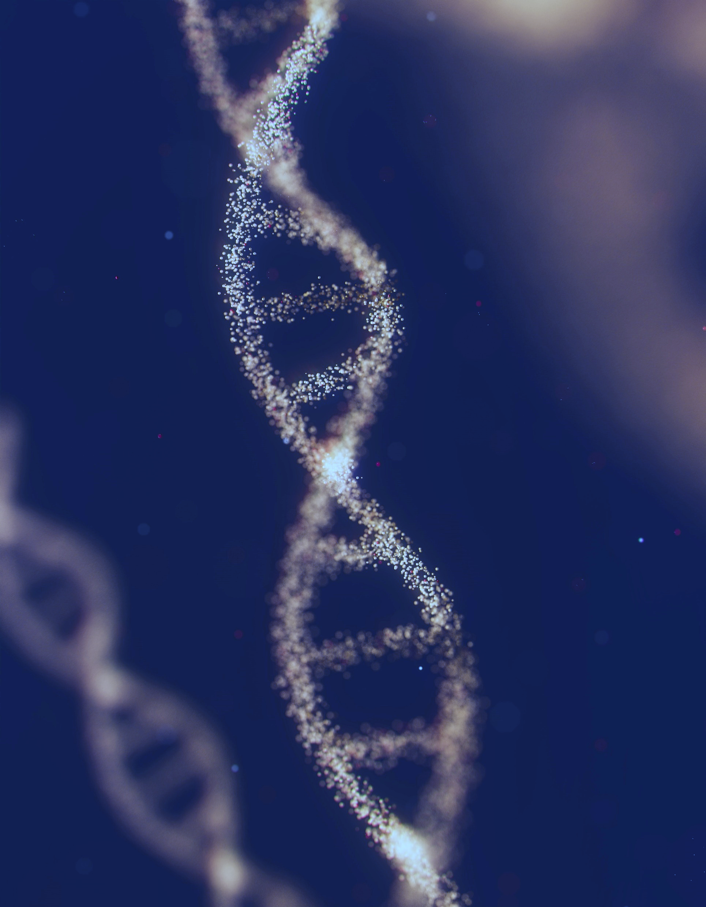
DSF Introduction
Kiana Lee Martinez, PhD
Postdoctoral Research Associate
Pharmacy Practice and Science
College of Pharmacy
THE UNIVERSITY OF ARIZONA
Anirudh Reddy
Notes:
I am a Postdoctoral Research Associate in the Karnes Laboratory in the College of Pharmacy at the University of Arizona.

Slide 2
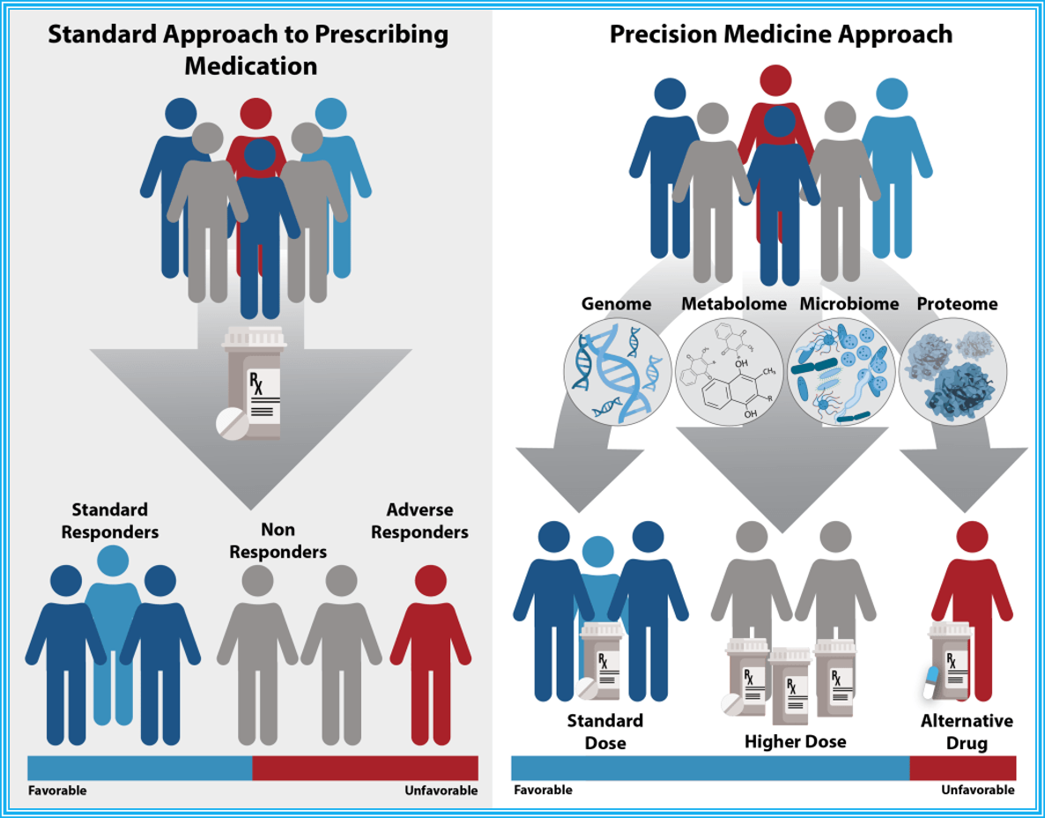
Precision Medicine:
an emerging approach for disease treatment and prevention that takes into account individual variability in genes, environment, and lifestyle for each person
Pharmacogenomics:
an approach used by precision medicine, is the study of how genes affect a person’s response to drugs
Notes:
As part of the Karnes Laboratory, my research broadly falls under the umbrella of precision medicine.

Slide 3
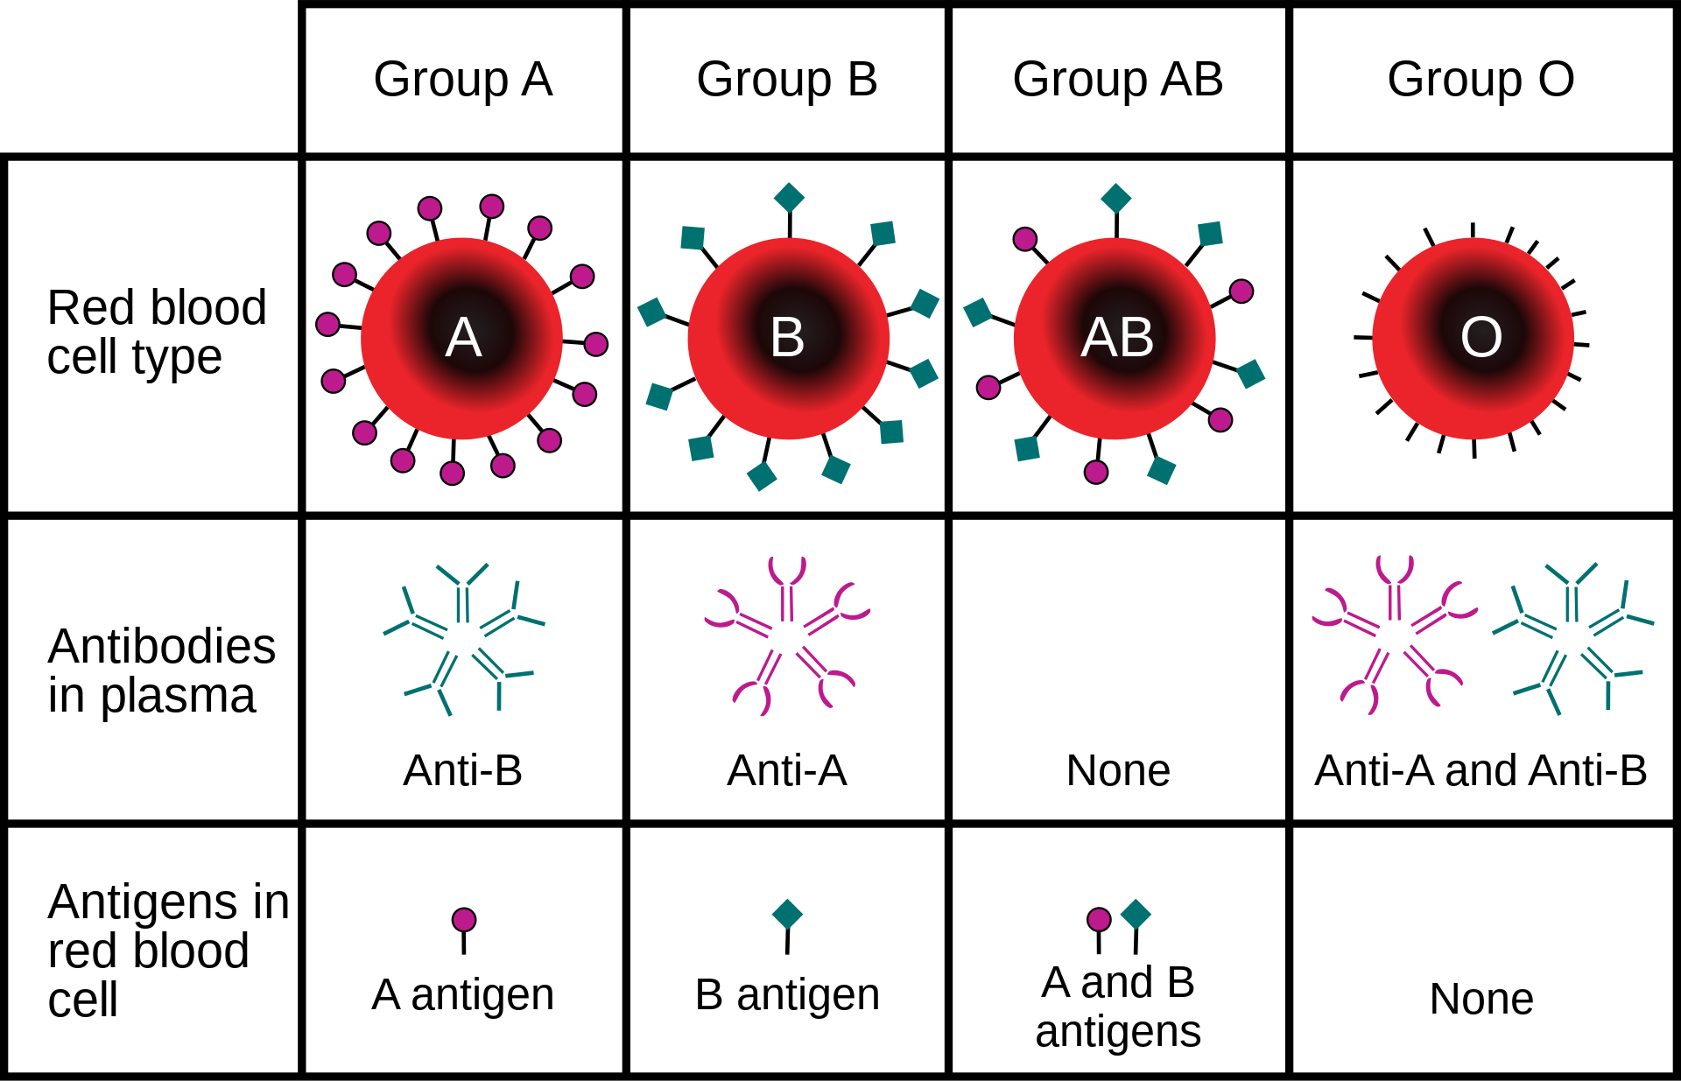
Phenotypes
What ABO blood types and subtypes associate with risk of disease?
ABO blood group system
Heparin-induced thrombocytopenia (HIT)
Warfarin
Notes:
In general the Karnes Lab is interested in cardiovascular phenotypes, and I dabble in ABO blood groups, HIT, and Warfarin

Slide 4
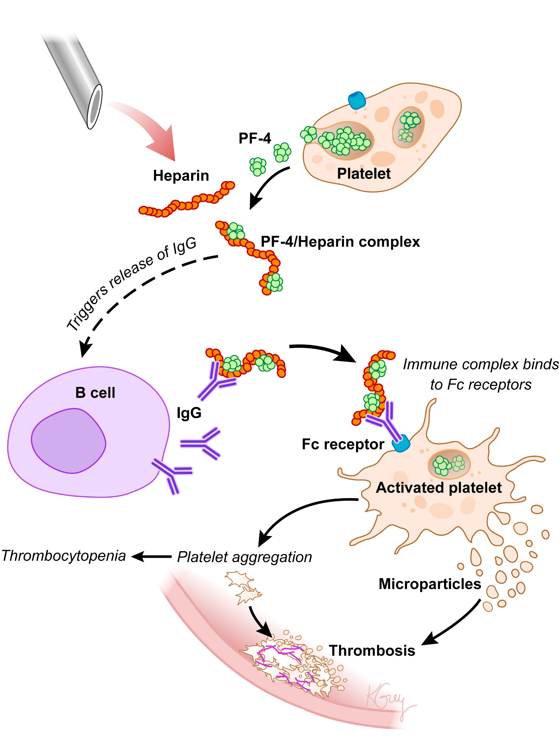
Phenotypes
Who is at risk for developing HIT?
ABO blood group system
Heparin-induced thrombocytopenia (HIT)
Warfarin
Notes:
HIT occurs when heparin (an anti-coagulant or blood thinner) initiates blood platelet activation which can then lead to thrombotic (blood clot) complications
-heparin is given for a lot of reasons (ex: prevent blood clotting during open-heart surgery or to treat blood vessel and heart conditions) so this important,
but there is risk in developing HIT which can result in heart attacks and strokes
The main question is finding out how we can determine who is at risk for developing HIT? One question we can ask is, can we identify any genetic variants that predispose you to developing HIT?

Slide 5
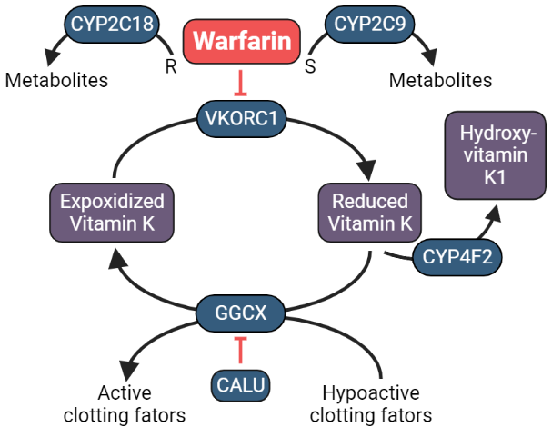
Phenotypes
What is the correct stable dose for individuals needing to take warfarin?
ABO blood group system
Heparin-induced thrombocytopenia (HIT)
Warfarin
Notes:
Warfarin is also an anticoagulant or blood thinner that is commonly used, but has two issue when it comes to dosing:
Dosing among patients is widely variable (5mgs vs 100mgs)
A narrow therapeutic window
Adverse reactions
Already know of some genomic variants in certain genes that influence how warfarin is metabolized and thus influences one’s proper stable dose. However, the issue is that most studies aimed on identifying influential genomic variants are done in populations of European ancestry which is not representative of our global population.
The concern isn’t that our genetics are so very different between populations, its that there may be different frequencies of alleles among populations.

Slide 6
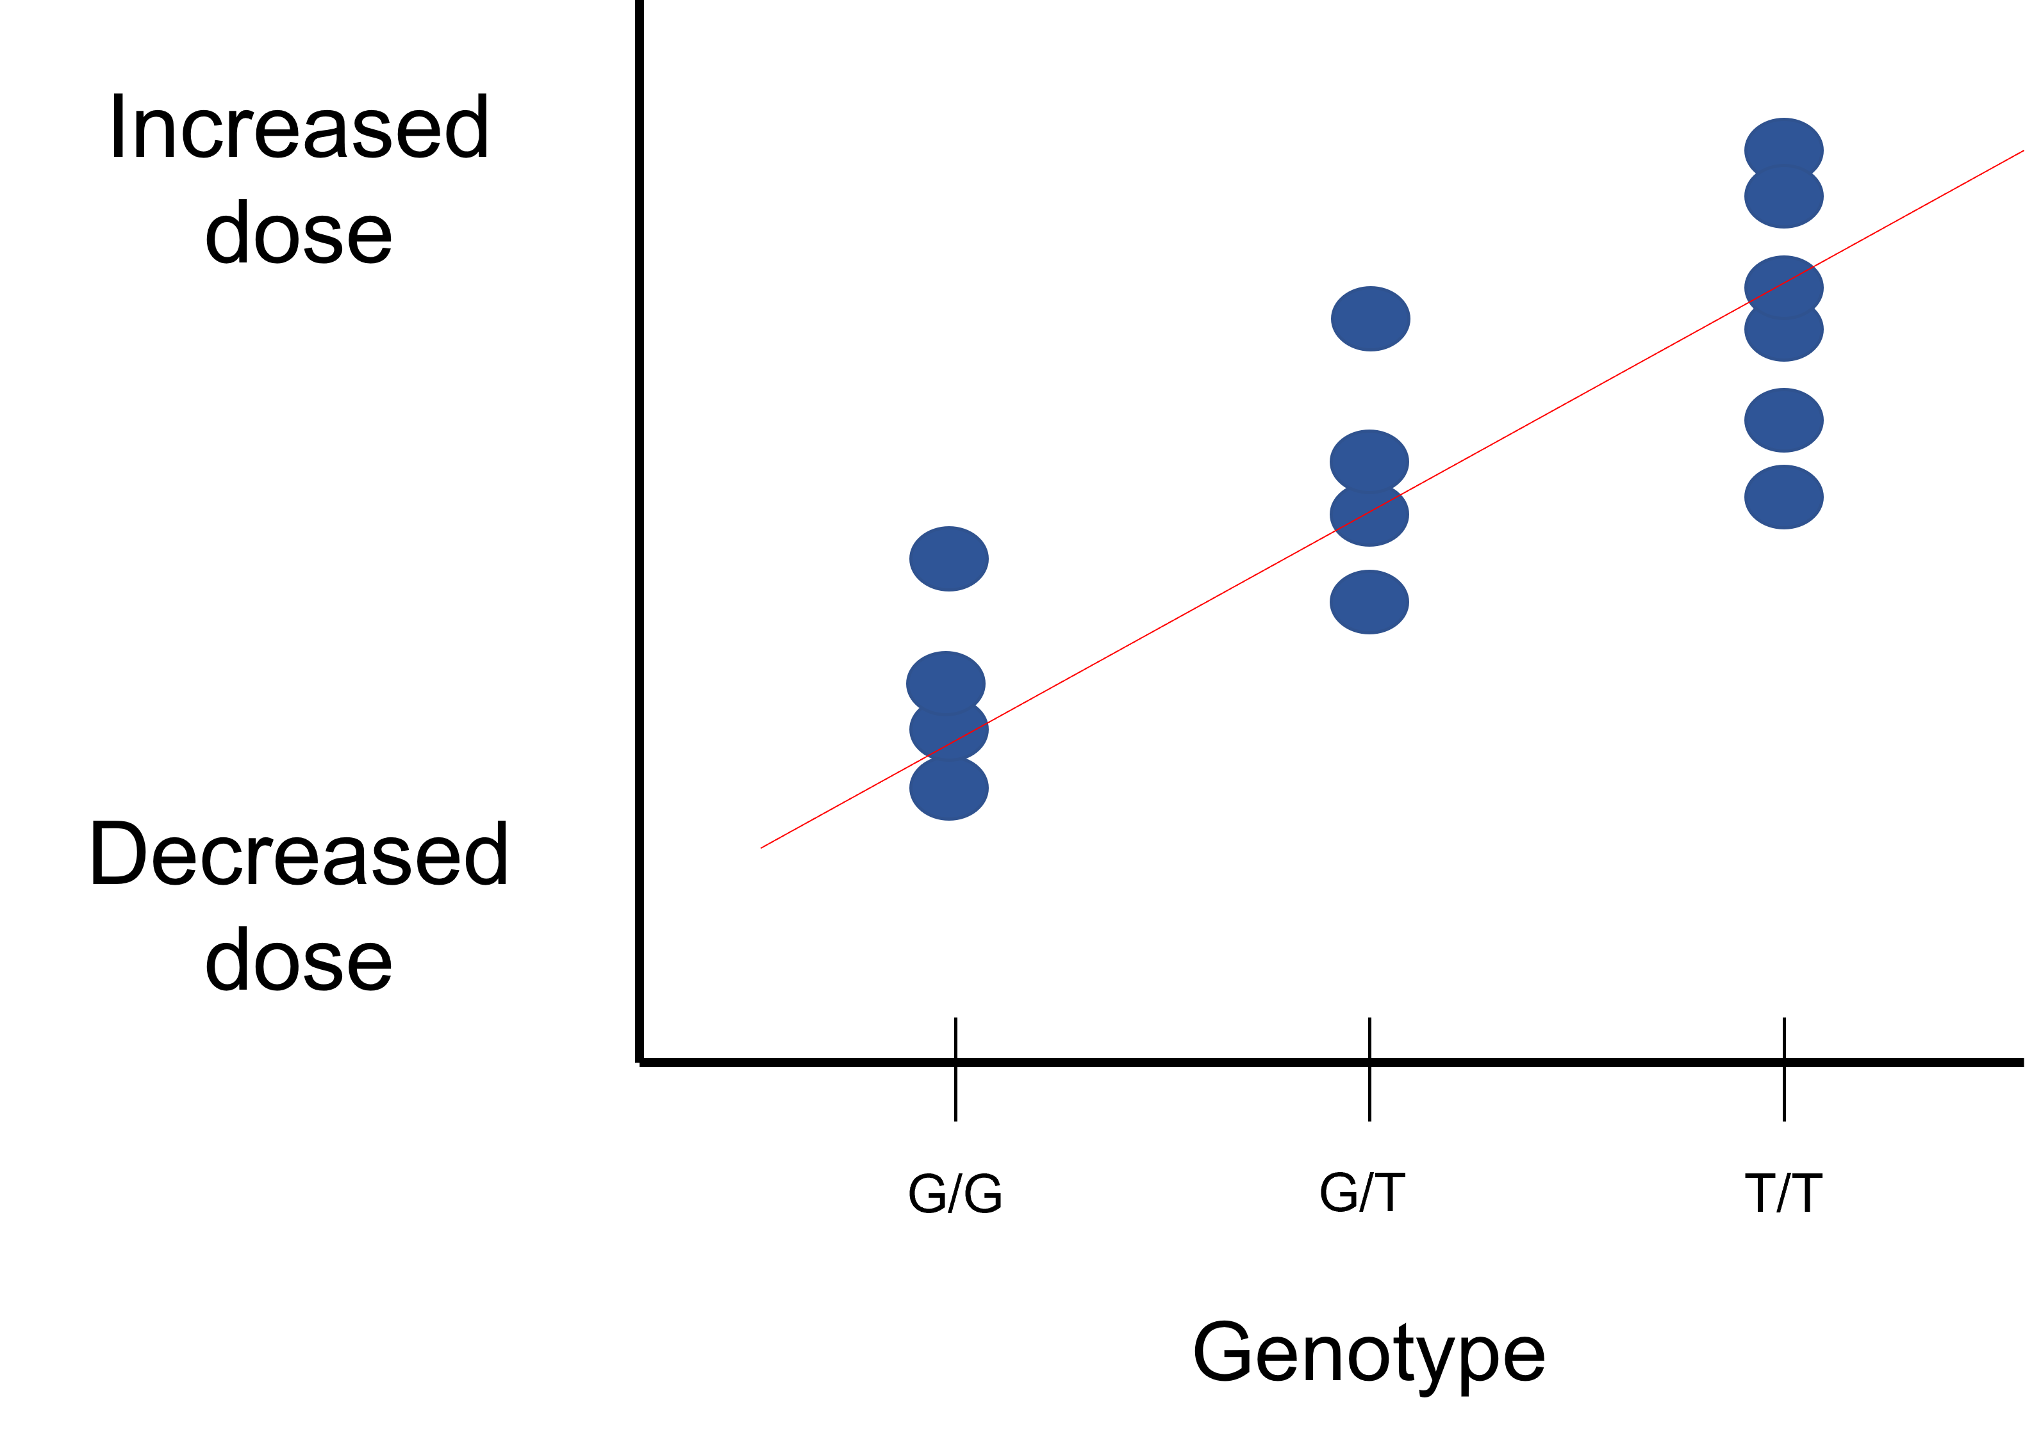
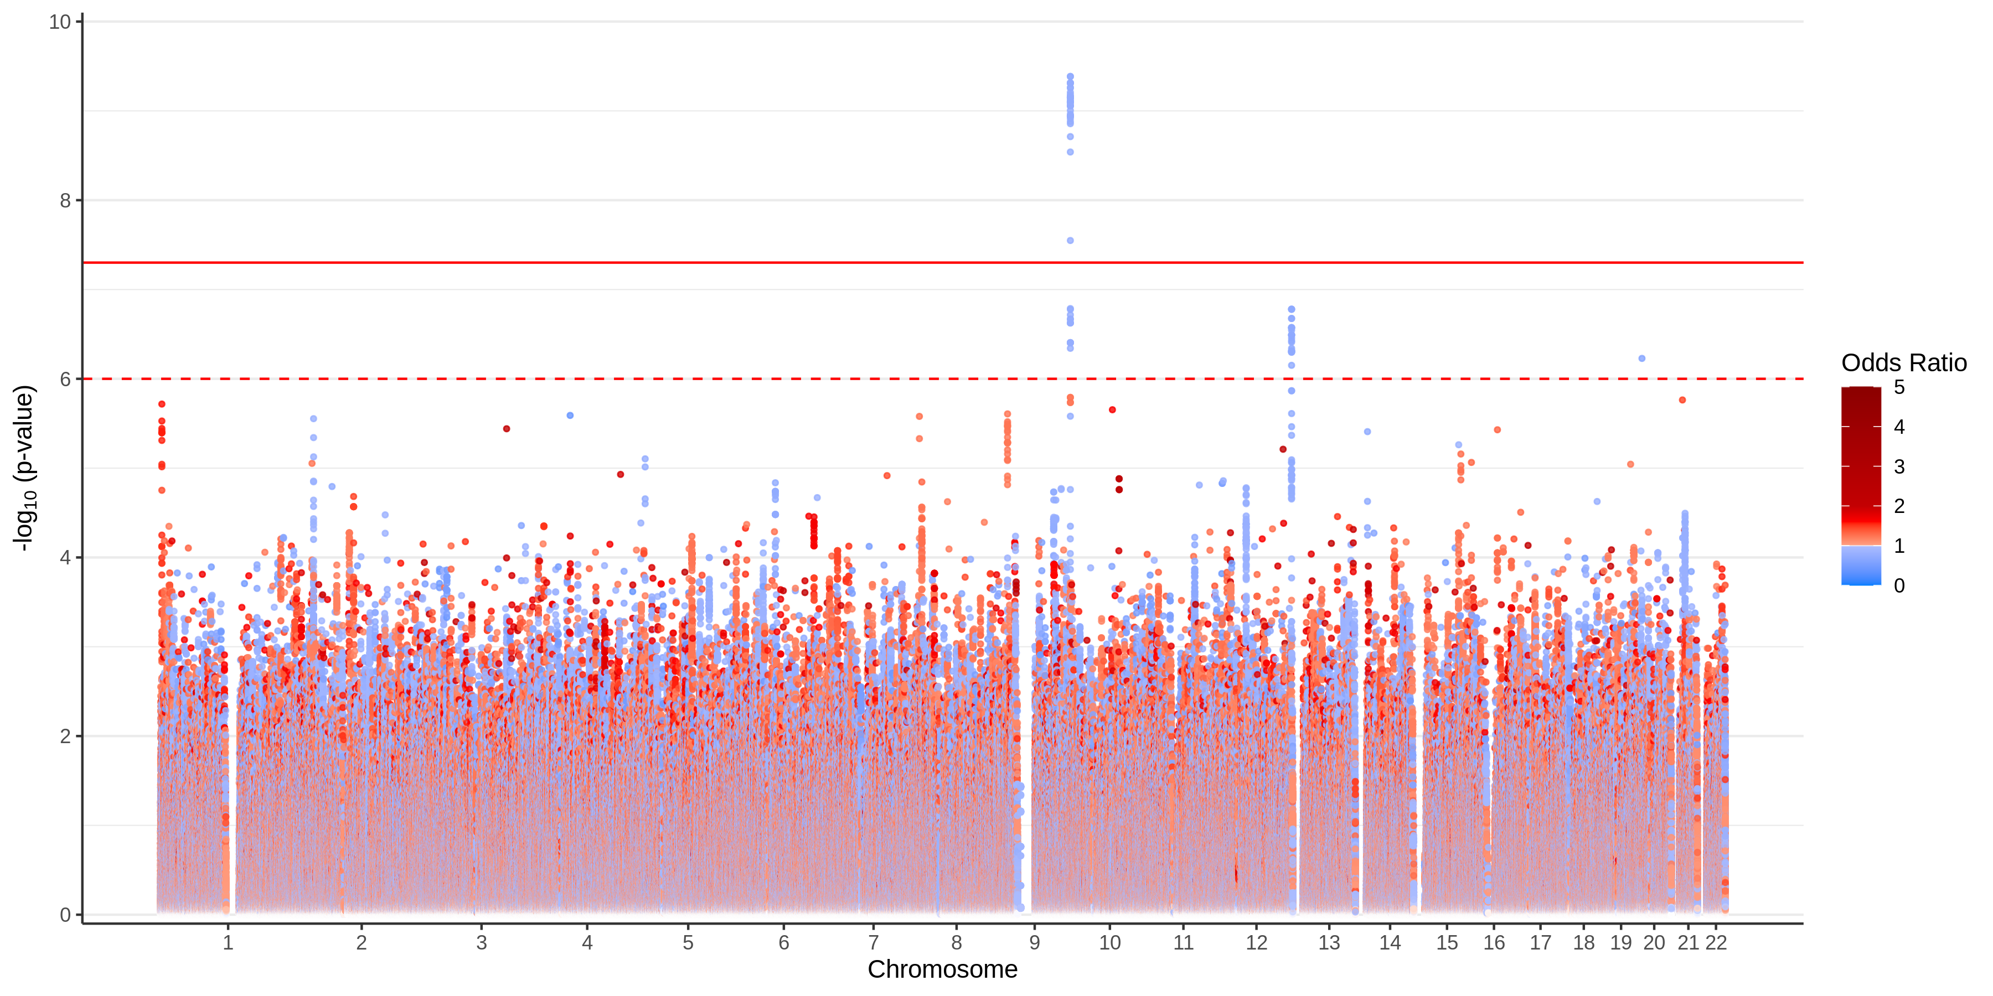
GWAS
Do this a million times than plot the p-values to look for a significant signal
Notes:
A commonly use hypothesis-generating approach we are taking is GWAS or genome-wide association studies to try to identify genomic variants associated with HIT or variability in Warfarin dosing.
So you are essentially doing a million regressions between a single genomic variant, and either a continuous trait or the absence or presence of disease, then plot the p-values with the variants on the x-axis and look for a variant that significantly associates with you phenotype

Slide 7
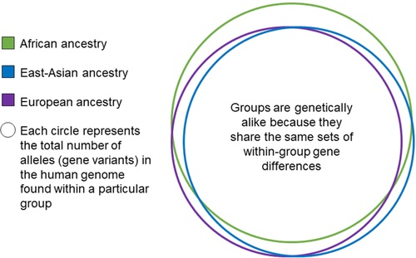
Building our models
Phenotype = Genotype and Environment
Also, should be noted that though there may be particular haplotypes that tend to segregate with specific populations, there is vastly more variation within populations than between populations
Notes:
An issue with past studies that have been done with warfarin and HIT, is that most of the studies have been in predominantly European populations. And the issue isn’t that our genetics are vastly different between whatever buckets we want to put people in, its that they may be slightly different prevalences of genetic variants in some populations. We want to have the full picture, not just one population. So we need to adjust our models to accommodate for population structure.
On that note

